Slide 1
DR SNSRCAS, CBE Human Centered Design Thinking Fundamentals 21PCA204 I MCA ODD SEM UNIT II Survey Results

Slide 2
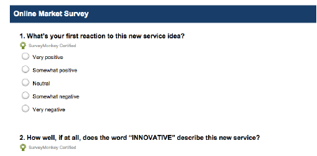
Survey Results
Steve Jobs once said that ”It isn’t the consumers’ job to know what they want”.
While that’s true since you don’t want a committee of customers designing the
product, survey results are still helpful as a baseline measurement. They certainly
aren’t mandatory for product success, but any insight into the customer mind is
better than guessing.

Slide 3
Survey Results
According to David Masters, Editor at Tuts+, online surveys are a low-cost tactic
that lets you see data patterns quickly. Focus groups and interviews can provide indepth
research, but they’re costly (find the potential customers, prepare questions,
pay people to interview, etc). If you’re short on resources, online surveys are a
leaner yet scalable way of gathering vast information — especially if you don’t have
a working prototype yet. If you decide on this simple route, here’s a few tips:
Be crystal clear on your goals — Who are you talking to, and what do you
want to know? Shorter is better, so make sure you only ask questions you need
answered. A 3-minute survey will give you cleaner data than a 20-minute one.
• Put ideas to paper — Draft every question you need answered. Once you have
a list of 10 to 15, phrase them in different ways that all focus on the issue at
hand.
• Edit ruthlessly — Group your original list into common themes and then
choose one out of each theme. Ideally, you want 5 questions. If you have more
than 8, start culling.

Slide 4
Survey Results
Craft your questions — Closed questions have a limited choice of answers.
These may be binary (yes/no) or multiple choice. Open-ended questions let
you discover things you never thought of and let you learn the language of
customers. Regardless of your choice, the simpler and shorter your questions,
the better your responses.
• Order your questions — Order matters. The most important questions go first.
If you need to follow up, ask questions last (if you ask them first, people will
ignore you because they don’t know you).
Jonathan Kochis, Partner at Treble Apps, used survey results to help define the
features of a consumer-facing mobile project for 3M Canada. If budget permits, he
42
advises investing in a research firm to refine your questions and find the perfect set
of participants. If you’re on a budget, following the above advice with Fluid Surveys
or SurveyMonkey can still get you good results. Regardless of your method, he
advises being highly selective with open-ended questions since they create friction
for respondents and can be difficult to interpret.

Slide 5
Survey Results
Constant Contact provides a comprehensive list of survey questions mapped to
answer choices. To get started, you can then use this sample survey template from
SurveyMonkey.

Slide 6
THANK YOU

